Slide 1

DESIGN AND ANALYSIS OF ALGORITHMS
Surabhi Narayan
Department of Computer Science & Engineering

Slide 2
DESIGN AND ANALYSIS OF ALGORITHMS
DECREASE AND CONQUER
Surabhi Narayan
Department of Computer Science & Engineering

Slide 3
DESIGN AND ANALYSIS OF ALGORITHMS
Decrease and Conquer
Decrease or reduce problem instance to smaller instance of the same problem and extend solution.
Conquer the problem by solving smaller instance of the problem.
Extend solution of smaller instance to obtain solution to original problem .
Exploit the relationship between a solution to a given instance of a problem and a solution to its smaller instance.
Can be implemented either top-down or bottom-up
Also referred to as inductive or incremental approach

Slide 4
DESIGN AND ANALYSIS OF ALGORITHMS
Decrease and Conquer
3 Types of Decrease and Conquer
Decrease by a constant (usually by 1):
  insertion sort
  graph traversal algorithms (DFS and BFS)
  topological sorting
  algorithms for generating permutations, subsets
Decrease by a constant factor (usually by half)
  binary search and bisection method
  exponentiation by squaring
  multiplication à la russe
Variable-size decrease
  Euclid’s algorithm
  selection by partition
  Nim-like games
  This usually results in a recursive algorithm.

Slide 5
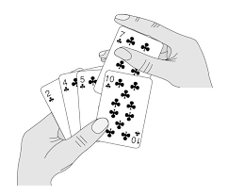
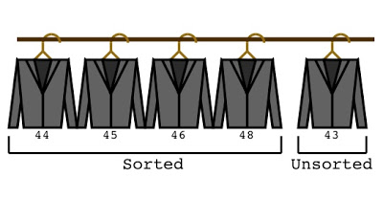
DESIGN AND ANALYSIS OF ALGORITHMS
Decrease and Conquer
Insertion Sort
Imagine a card game
Cards in your hand are sorted.
The dealer hands you exactly one new card.
How would you rearrange your cards

Slide 6
DESIGN AND ANALYSIS OF ALGORITHMS
Decrease and Conquer
Insertion Sort
Insertion sort is based on the idea that one element from the input elements is consumed in each iteration to find its correct position i.e, the position to which it belongs in a sorted array.
grows the sorted array at each iteration
compares the current element with the largest value in the sorted array.
If the current element is greater, then it leaves the element in its place and moves on to the next element else it finds its correct position in the sorted array and moves it to that position.
This is done by shifting all the elements, which are larger than the current element, in the sorted array to one position ahead

Slide 7
DESIGN AND ANALYSIS OF ALGORITHMS
Decrease and Conquer
Insertion Sort
To sort array A[0..n-1], sort A[0..n-2] recursively and then insert A[n-1] in its proper place among the sorted A[0..n-2]
Usually implemented bottom up (nonrecursively)
Example: Sort 6, 4, 1, 8, 5
6 | 4 1 8 5
4 6 | 1 8 5
1 4 6 | 8 5
1 4 6 8 | 5
1 4 5 6 8

Slide 8
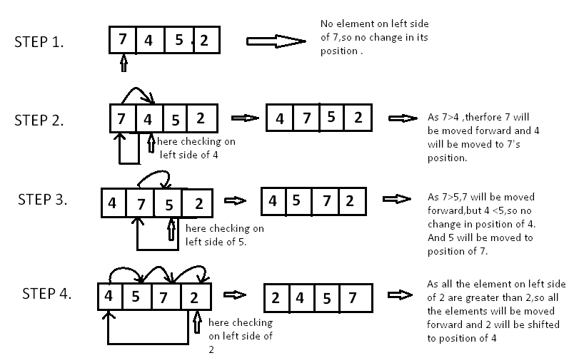
DESIGN AND ANALYSIS OF ALGORITHMS
Decrease and Conquer
Insertion Sort

Slide 9
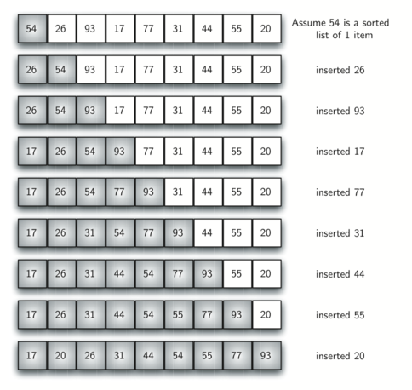
DESIGN AND ANALYSIS OF ALGORITHMS
Decrease and Conquer
Insertion Sort

Slide 10
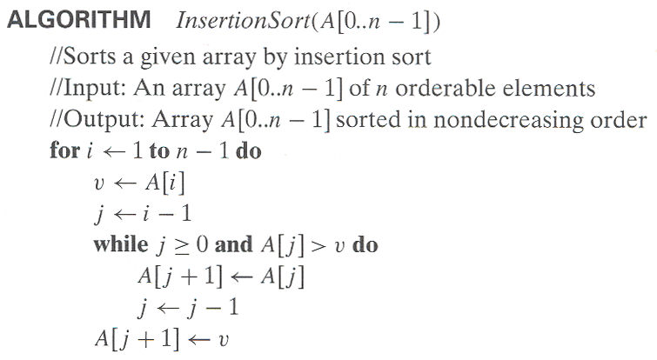
DESIGN AND ANALYSIS OF ALGORITHMS
Decrease and Conquer

Slide 11
DESIGN AND ANALYSIS OF ALGORITHMS
Decrease and Conquer
Time efficiency
C_{worst}(n) = n(n-1)/2 ∈ Θ(n²)
C_{avg}(n) ≈ n²/4 ∈ Θ(n²)
C_{best}(n) = n - 1 ∈ Θ(n) (also fast on almost sorted arrays)
Space efficiency: in-place
Stability: yes
Best elementary sorting algorithm overall
Binary insertion sort

Slide 12
THANK YOU
Surabhi Narayan
Department of Computer Science &Engineering
surabhinarayan@pes.edu

